Slide 1
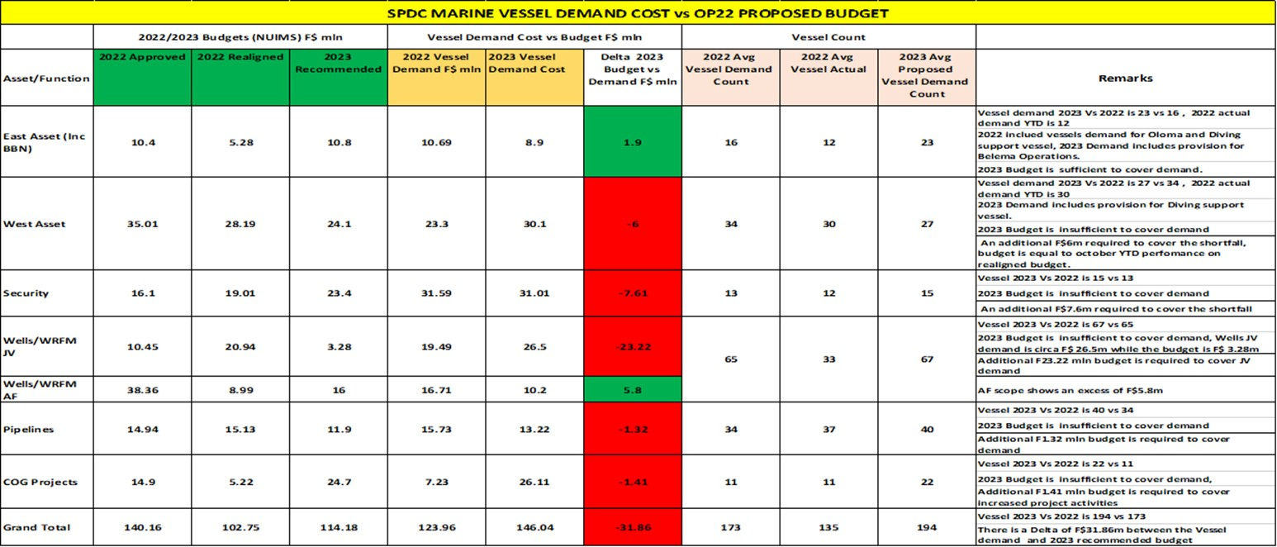
OP 22 MARINE EQUIPMENT DEMAND VS BUDGET UPDATE
2023 vs 2022 Vessels Demand count : 194 vs 173. Up by 12%. Major demand upside from Project and Belema. 2022 YTD Average demand (128) well below plan of 173.
2023 vs 2022 Vessels Demand cost : $146m vs $124m. Up by 18%.
OP 22 Demand Cost vs NAPIMS recommended : $146m vs $114.2m. Deficit ($ 31.86m). 2022 NUIMS realigned is $102m. OP22 is $12m above OP21 realigned budget
Wells /WRFM JV, Security and West Asset accounts for the major gap between demand and recommended budget. Further internal review and realignment planned

